Slide 1
Which Speaks Louder?
Actions or
Words
A Quiz on Anticorruption from other Transition Countries

Slide 2
1. Corruption is an intractible problem that takes generations to reduce. (True of False?)
 |  | True
 | ✓ | False
… although it can never be eliminated.

Slide 3
Some transition countries saw administrative corruption fall from 2002 to 2005
Source: James H. Anderson and Cheryl W. Gray (2006) Anticorruption in Transition 3—Who is Succeeding … And Why? World Bank. Washington, DC. http://www.worldbank.org/eca/act3

Slide 4
… and again from 2005 to 2008
Note: The samples for 2005 were restricted to match those of 2008 and this is the reason that the levels for 2005 do not match exactly those of 2005 in the previous slide.
Source: Stephen Knack and Gregory Kisunko (2011) Trends in Corruption and Regulatory Burden in Eastern Europe and Central Asia World Bank. Washington, DC. http://go.worldbank.org/P2ARLKNWO0

Slide 5
2. The same countries greatly opened and simplified their governments. (True of False?)
 | ✓ | True
 |  | False

Slide 6
 | Access to Information Laws | Assets declarations available to the public | Administrative simplification
Bulgaria | ✓ | ✓ | ✓
Romania | ✓ | ✓ | ✓
Georgia | ✓ | ✓ | ✓

Slide 7
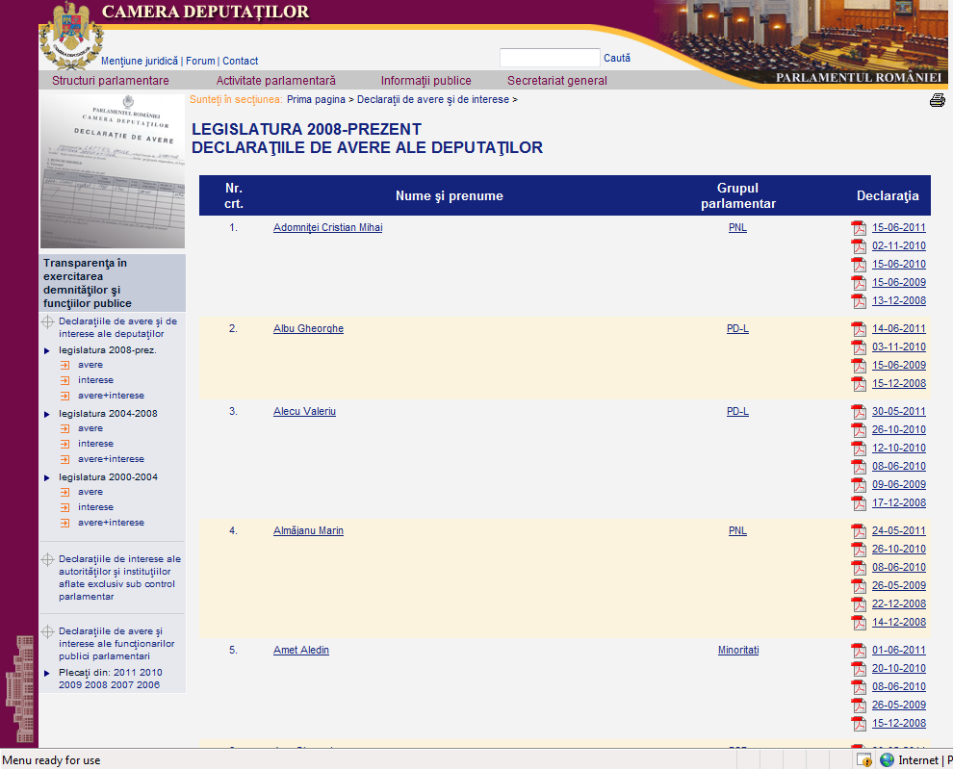
Declarations of Assets and Interests Online (Romania)

Slide 8
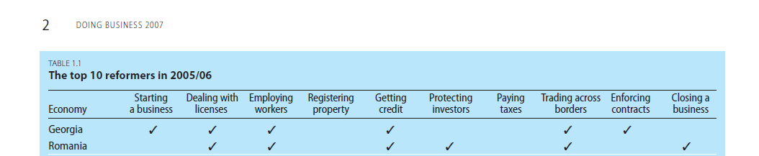
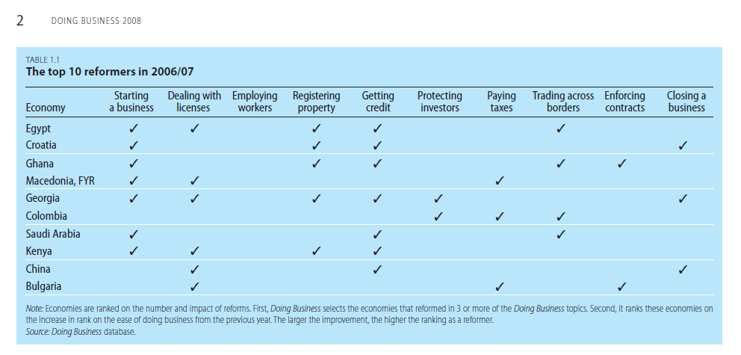
Ambitious programs of administrative simplification

Slide 9
3. Corruption is corruption. (True of False?)
 |  | True
 | ✓ | False
There are wide variations across countries and sectors.

Slide 10
Reductions focused in certain areas
2002-2005
Source: James H. Anderson and Cheryl W. Gray (2006) Anticorruption in Transition 3—Who is Succeeding … And Why? World Bank. Washington, DC. www.worldbank.org/eca/act3

Slide 11
4. Technical solutions can help reduce corruption. (True of False?)
 | ✓ | True
 |  | False

Slide 12
Reducing Customs Clearance Times at Constanta, Romania

Slide 13
5. Technical solutions are sufficient for reducing corruption. (True of False?)
 |  | True
 | ✓ | False

Slide 14
Political Will=Real Action
Tough measures
  Establishing independence for investigative bodies.
  Investigations of high level officials for asset declarations
  Publicizing assets
  Open access to information
Sharp measures to shift expectations
  Firing all traffic police in Georgia
→Problems persist, but progress is possible

Slide 15
What will be Vietnam’s bold step to shift expectations and reduce corruption?

