Slide 1
Diagnosing corruption in Viet Nam: How to make best use of increasing available evidence?
Jairo Acuña-Alfaro
Policy Advisor, UNDP Viet Nam
jairo.acuna@undp.org
Presentation prepared for Anti-Corruption Dialogue Roundtable Discussion
Session 1 – “Understanding about Corruption and where we are?”
November, 2011, Ha Noi

Slide 2
Contents – Outline of presentation
A timeline view
What?
  Do we know better now?
  What is the evidence telling us?
How?
  How do we use this evidence?
  How does this evidence support policy making?
  How does this evidence support implementation?

Slide 3
A timeline view of a sample of corruption surveys
Viet Nam specific
Corruption specific
Significant coverage (n)
Sociological Survey on Corruption Risks in the Management of Mineral Resource Exploitation - GI
Corruption Risks in the Issuance and Transfers of Land Use Rights & House Ownership - GI
Provincial Governance and Public Administration Performance – VFF, CECODES, UNDP
Provincial Governance and Public Administration Performance – VFF, CECODES, UNDP
Online Survey on Public Administrative Procedures – VNNet, UNDP
Assessment of Corruption Behavior in the Education Sector - GI
AC Diagnostics Study – GI/OSCAC
Global Corruption Barometer – TI and Towards Transparency
Provincial Competitiveness Index– VCCI, VNCi, USAiD
Pilot Provincial Governance and PAPI – VFF, CECODES, UNDP
Provincial Competitiveness Index– VCCI, VNCi, USAiD
Provincial Competitiveness Index– VCCI, VNCi, USAiD
Provincial Competitiveness Index– VCCI, VNCi, USAiD
Youth Integrity Survey – TI – Towards Transparency et al.
VHLSS Pilot Governance Module– MPI/GSO, WB
Provincial Competitiveness Index– VCCI, VNCi, USAiD
Provincial Competitiveness Index– VCCI, VNCi, USAiD
AC Diagnostics Study - CPV
Provincial Competitiveness Index– VCCI, VNCi, USAiD
World Bank Enterprise Survey
World Bank Enterprise Survey
Enterprise Survey - GSO
Enterprise Survey - GSO
2005 | 2006 | 2007 | 2008 | 2009 | 2010 | 2011 | 2012

Slide 4
“Systemic” problem of corruption!
Source: Own estimates based on the 2008 VHLSS Governance Module. Presented in Vietnam Development Report 2010—Modern Institutions.
Source: Global Corruption Barometer, 2010. Towards Transparency Vietnam and Transparency International.
Average perception of corrupt behaviors:
youth versus adults
Source: Provincial Governance and Public Administration Performance Index (PAPI). VFF, CECODES, UNDP
Source: Youth Integrity Survey, 2011. Towards Transparency et al

Slide 5
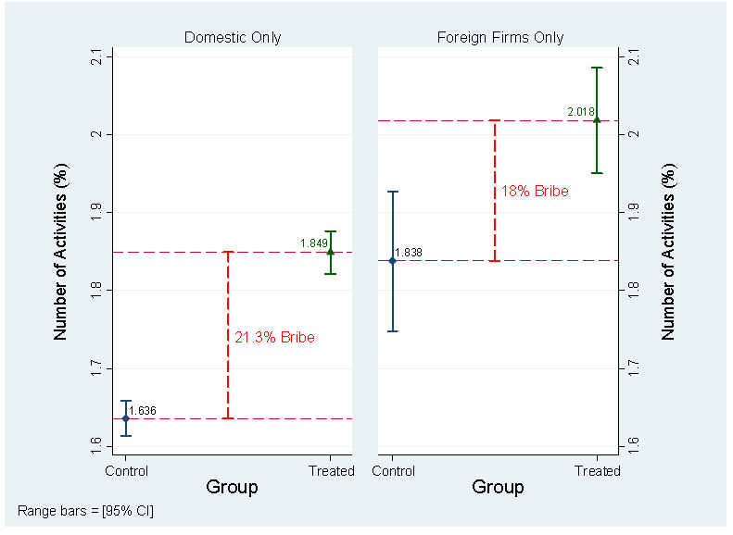
Propensity to Bribes at Public Notary and Hospitals by citizens
“Systemic” problem of bribery!
Extra payments in order to get public services
68.75% of respondents had to pay extra in order to get a
public service or administrative procedure done
Source: Online Survey on Administrative Procedures, 2010. Vietnamnet, UNDP.
Propensity to Bribe During Business Registration
Source: Provincial Governance and Public Administration Performance Index (PAPI). VFF, CECODES, UNDP.
Percentage of respondents who report paying bribes in the past year to different service providers?
Viet Nam in group 2 countries –
between 30% and 49.9%
Source: Global Corruption Barometer, 2010. Towards Transparency Vietnam and
Transparency International.
Source: Provincial Competitiveness Index (PCI), 2010. VCCI, VNCi.

Slide 6
Some noticeable, yet marginal, changes in business sector
Reduction in the assessment of corruption (among others) as a problem from 2005 to 2009
Source: World Bank Enterprise Surveys 2005 – 2009.
Source: Provincial Competitiveness Index (PCI).

Slide 7
The changing nature of corruption… different tools, levels, sectors
Most corrupted organizations
(2005)
Perceived corruption by sectors
(2010)
1 | Cadastral and housing agency
2 | Customs/import-export management agency
3 | Traffic police
4 | Public finance and tax agency
5 | Management/entities in construction industry
6 | Construction permit-granting agency
7 | Health care entity
8 | Planning and Investment agency
9 | Management/entities in transport industry
10 | Economic police
Source: Global Corruption Barometer, 2010. Towards Transparency Vietnam and Transparency International.
Source: AC Diagnostics Study, 2005 – CPV. Table 2.12, page 36-37.

Slide 8
Different levels of “Control of Corruption” at provincial levels
Top 8 and 12 of top 15 are southern provinces
Dimension with highest variance
Large differences in scores between the low and the high performers (HCM 6.3 points vs Kon Tum’s 3.4 points)
  Equity in employment in the public sector at the grassroots level tends to be most problematic and to vary greatly between provinces.
Source: Provincial Governance and Public Administration Performance Index (PAPI). VFF, CECODES, UNDP

Slide 9
Size of Bribe Required Necessitating Formal Action
How much bribe are individual citizens’ willing to endure before taking formal action with a local inspectorate across the country?
Very little difference between tolerance for bribes demanded by the policeman or the commune official.
Citizens, on average, appear to tolerate bribes up to about 100,000VND (~ 5 usd) from both actors, where only 30% of respondents are willing to appeal.
A large jump takes place between 100,000 and 500,000VND (~ 25 usd), where the proportion of respondents willing to appeal doubles.
At 10 million VND (~ 500 usd), however, there are still 10% who cannot bring themselves to appeal a corrupt act.
Source: Provincial Governance and Public Administration Performance Index (PAPI). VFF, CECODES, UNDP

Slide 10
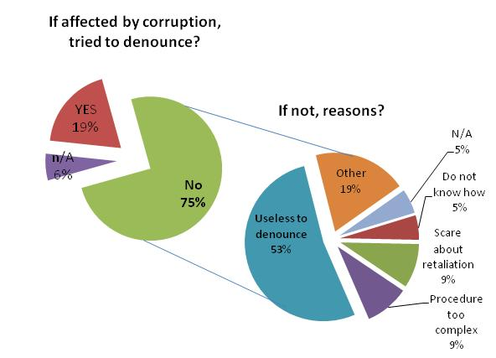
Why are individuals having difficulties to denounce?
A challenging environment to “denounce” and/or “report”
Civil servants and businesses
Citizens
“Survey results showed that 85.4% of civil servants and 78.2% of business staff are not enthusiastic in fighting corruption as they are afraid of being victimized”
Source: 2005 Anti-Corruption Diagnostics. CPV. p.56.
Source: Provincial Governance and Public Administration Performance Index (PAPI). VFF, CECODES, UNDP

Slide 11
A changing landscape, but …
Lights
Shadows
More evidence and information – what gets measured gets monitored!
Increased number of information / data providers
More actors, tools and frameworks to monitor and prevent corruption
Clearer identification of problems and areas prone to corruption / bribery
Opening up of space for evidence –based discussions
Enhanced capacities for diagnosing corruption
Initial indications of evidence informing policy – central & local
Data overload?
Difference in methodologies
  Scope / purpose
  Objective
  Quality – what you don’t know can hurt you!
Data “averse” policy making / implementation culture
Limited diagnosing of anti-corruption? i.e. solutions
Challenge ahead:
  From monitoring to enforcement

Slide 12
How …?
… is this evidence used?
… is this evidence supporting policy making?
… is this evidence supporting implementation?
  Government and policy-makers
  Anti-Corruption agencies
  Development partners, including civil society organizations
  Media

Slide 13
Some final thoughts
Becoming increasingly sophisticated in diagnosing corruption
  But what about in prescribing solutions/remedies for better anti-corruption?
Does a “systemic” problem requires a “systemic” solution?
  Critical question and premise is whether AC agencies have the skills, capacity and tools to effectively monitor and evaluate corruption and decision-makers
  Corruption as a political problem - strong anti-corruption agencies (i.e mandates, resources and capabilities) are crucial.
  Technical solutions not enough – from discourse to real power for oversight
Align diagnosing tools with prescribing of solutions
  Enhance follow up on measurement and monitoring tools
  Role of ongoing M&E system developed by GI
  Use of data and evidence to highlight progress – going beyond the rhetoric

Slide 14
Diagnosing corruption in Viet Nam: How to make best use of increasing available evidence?
Jairo Acuña-Alfaro
Policy Advisor, UNDP Viet Nam
jairo.acuna@undp.org
Presentation prepared for Anti-Corruption Dialogue Roundtable Discussion
Session 1 – “Understanding about Corruption and where we are?”
November, 2011, Ha Noi
The views expressed in this presentation do not necessarily reflect the official views or
positions of the United Nations, UNDP Viet Nam or partner organizations.

